Slide 1
Threads
Lecturer: Li Yang
Contact: liyang23@swjtu.edu.cn
Office: X31506
Faculty: Computer and AI

Slide 2
Chapter 4: Threads
Process and threads
Types of Threads
Multicore / Multithread

Slide 3
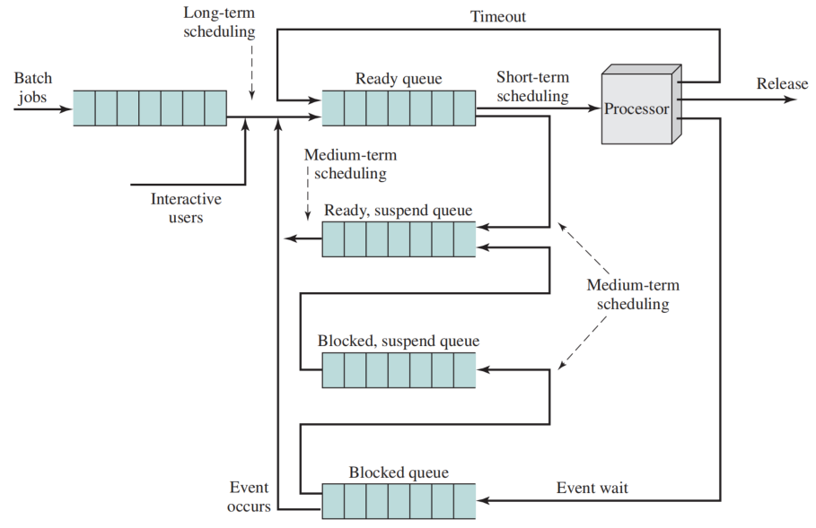
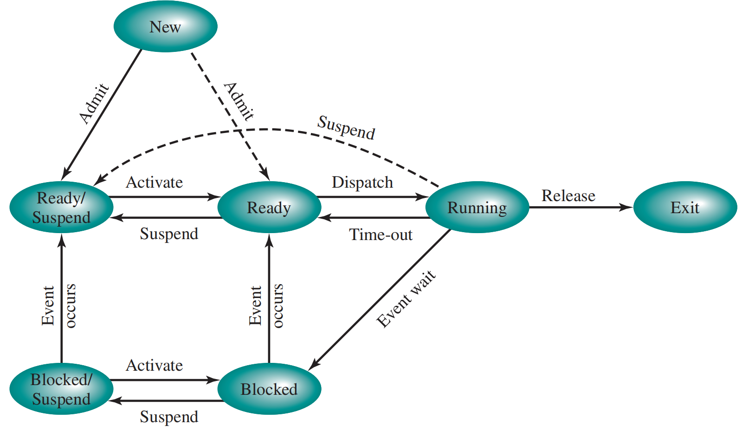
Previous Content
Process state (2, 5, 7)

Slide 4
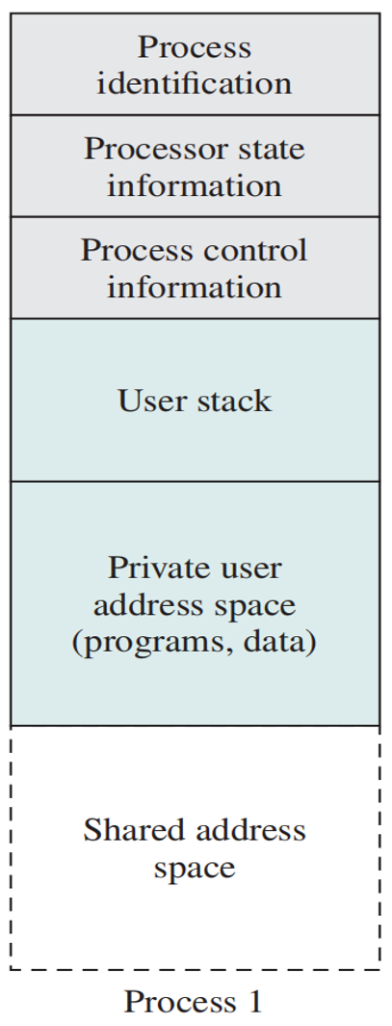
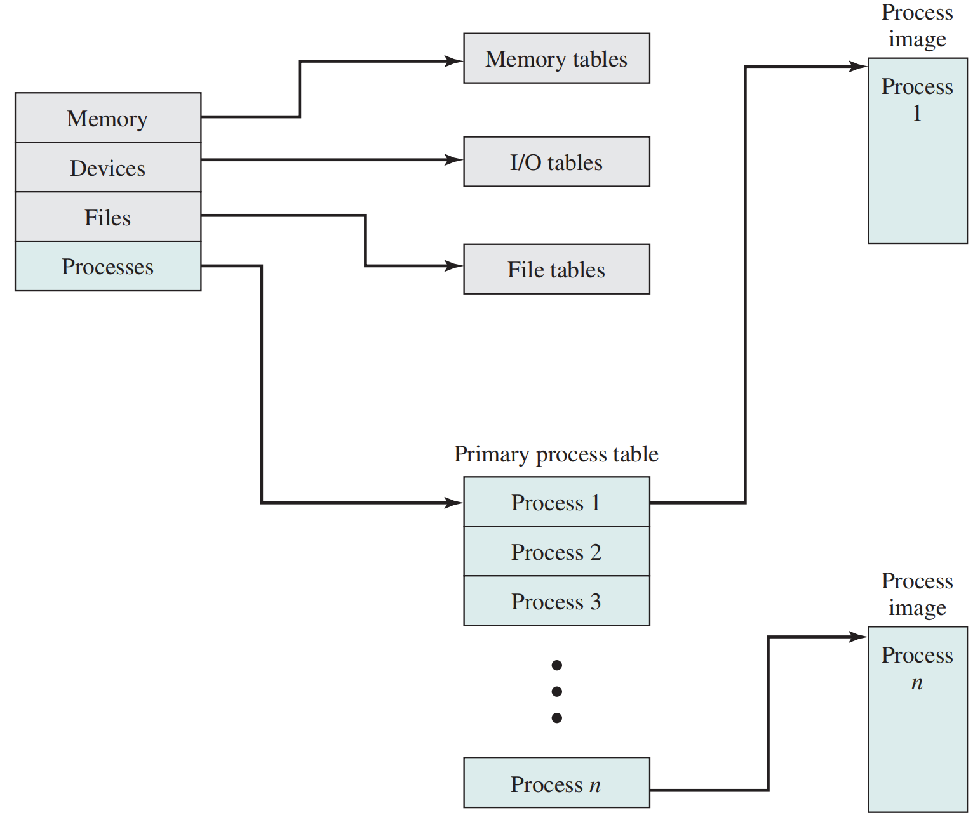
Previous Content
Process Image

Slide 5

Previous Content
Model of Execution

Slide 6
Previous Content
Process Switch
  save the context of the processor
  update the process control block of the process currently in the running state
  move the process control block of this process to the appropriate queue
  select another process for execution
  update the process control block of the process selected
  update memory management data structures
  restore the context of the processor to that which existed at the time the selected process was last switched out

Slide 7
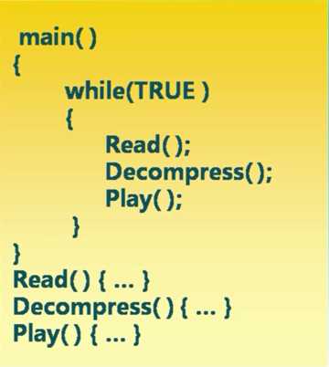
A Mp3 application

Slide 8
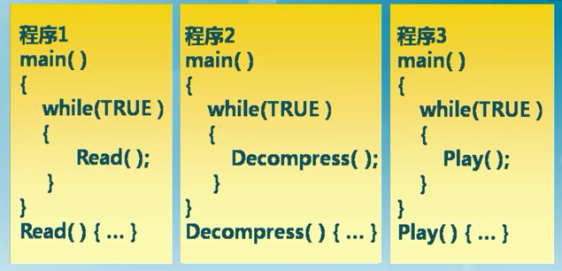
A Mp3 application

Slide 9
4.1 Processes and Threads
Processes have two characteristics:
  Resource Ownership
    Process includes a virtual address space to hold the process image
    OS performs a protection function to prevent unwanted interference between processes with respect to resources, such as processors, main memory, files and I/O resources
  Scheduling/Execution
    Follows an execution path that may be interleaved with other processes
    A process has an execution state (Running, Ready, etc.) and a dispatching priority
    A process is scheduled and dispatched by the OS

Slide 10
Processes and Threads
Differences:
  The unit of dispatching is referred to as a thread or lightweight process
  The unit of resource ownership is referred to as a process or task
  Multithreading - The ability of an OS to support multiple, concurrent paths of execution within a single process

Slide 11
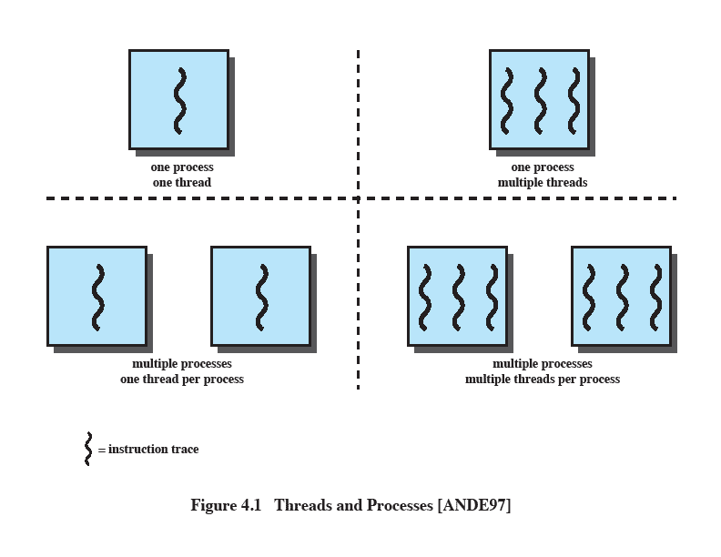
Single Threaded Approaches
A single thread of execution per process
  the concept of a thread is not recognized
MS-DOS
Traditional Unix
The implement methods of an application

Slide 12
Multithreaded Approaches
The right half depicts multithreaded approaches
A Java run-time environment is an example of a system of one process with multiple threads
Windows, Solaris and modern Unix are multiple processes with multiple threads
The implement methods of an application

Slide 13
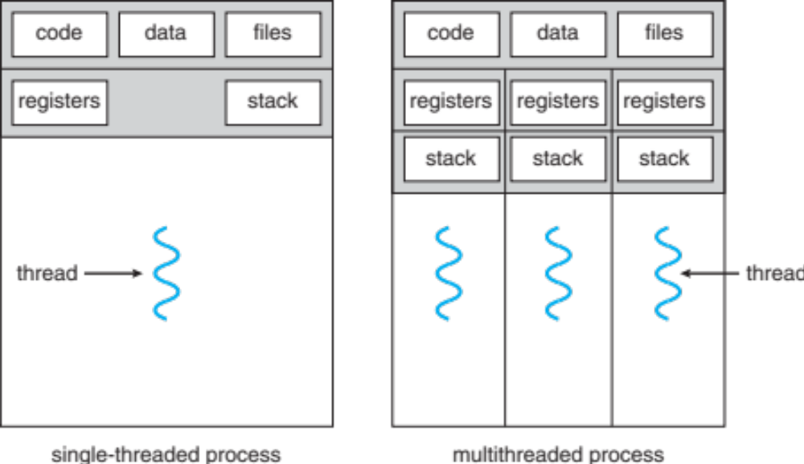
Single and multiple threads process

Slide 14
One or More Threads in a Process
Each process has
  A virtual address space that holds the process image
  The unit of resource allocation and a unit of protection
  Protected access to:
    processors
    other processes
    files
    I/O resources
One or more threads in process, and each has:
  an execution state (Running, Ready, etc.)
  an execution stack
  saved thread context when not running
  static storage for local variables
  access to the memory and resources of its process (all threads of a process share this)

Slide 15
Single-Threaded and Multithreaded Process Models
Share the process state and address space

Slide 16
Benefits of Threads
Less time to terminate a thread than a process
Threads enhance efficiency in communication between programs
Switching between two threads takes less time than switching between processes
Takes less time to create a new thread than a process
A collection of thread is more efficient to a collection of separate processes!

Slide 17
Thread Usage in a Single-user in Multi-Processor System
Foreground and background work
Asynchronous processing
Speed of execution
Modular program structure
Notes:
前台和后台工作：例如，在电子表格程序中， 一个线程可以显示菜单并读取用户输入，而另一个线程执行用户命令并更新电子表格。这种安排通常允许程序在上一个命令完成之前提示输入下一个命令，从而提高应用程序的感知速度。
• 异步处理：程序中的异步元素可以 作为线程实现。例如，为了防止电源故障，可以设计一个字处理器，使其随机存取存储器 （RAM） 缓冲区每分钟写入磁盘一次。可以创建一个线程，其唯一工作是定期备份，并且直接与 OS 调度自身;主程序中不需要花哨的代码来提供时间检查或协调输入和输出。
• 执行速度：多线程进程可以计算一批数据 从设备读取下一批时。在多处理器系统上，来自同一进程的多个线程可能能够同时执行。因此，即使一个线程可能被阻塞以使 I/O作读取一批数据，另一个线程也可能正在执行。
• 模块化项目结构：涉及各种活动或 使用线程可以更轻松地设计和实现输入和输出的各种源和目标。

Slide 18
Threads
In an OS that supports threads, scheduling and dispatching is done on a thread basis
Most of the state information dealing with execution is maintained in thread-level data structures
  suspending a process involves suspending all threads of the process
  termination of a process terminates all threads within the process

Slide 19
Thread States
The key states for a thread are:
  Running
  Ready
  Blocked
Thread operations associated with a change in thread state are:
  Spawn（派生）: a thread within a process may spawn another thread within the same process. The new thread is placed on the Ready queue.
  Block: waiting for an event, running->block
  Unblock: waited event occurs , block->ready queue
  Finish: a thread completes, the register context and stacks are deallocated.

Slide 20
Questions
Whether the thread is in a blocked state？
Whether the blocking of a thread results in the blocking of the entire process?
Suspend state is a process-level concept.
If yes, The flexibility of threads will partially fail.

Slide 21
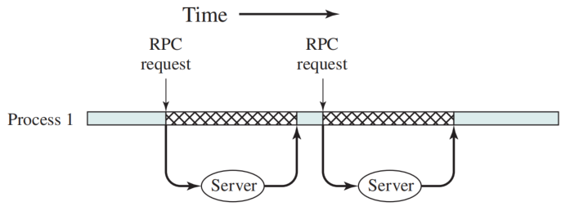
Remote Procedure Call (RPC) Using Single Thread
An example of performance benefits of threads that do not block an entire process
In a single-threaded program, the results are obtained in sequence, so the program has to wait for a response from each server in turn
A program that performs two remote procedure calls (RPCs)2 to two different hosts to obtain a combined result.

Slide 22
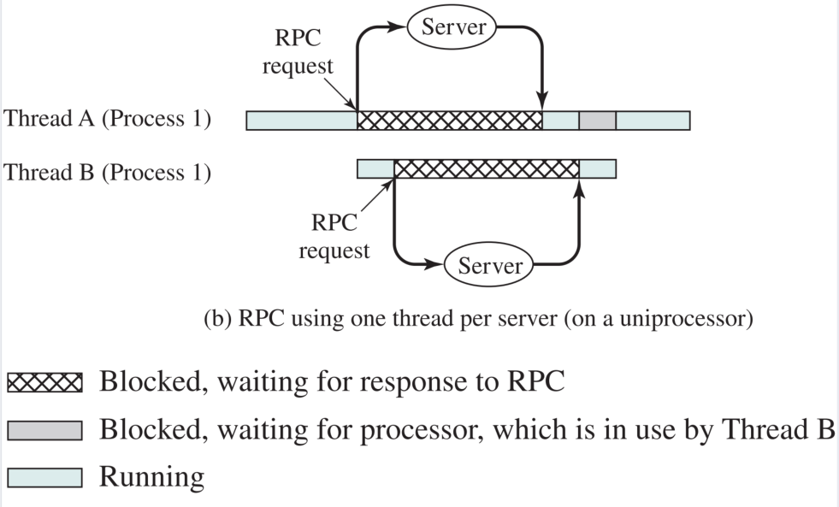

RPC Using One Thread per Server
Rewriting the program to use a separate thread for each RPC results in a substantial speedup

Slide 23
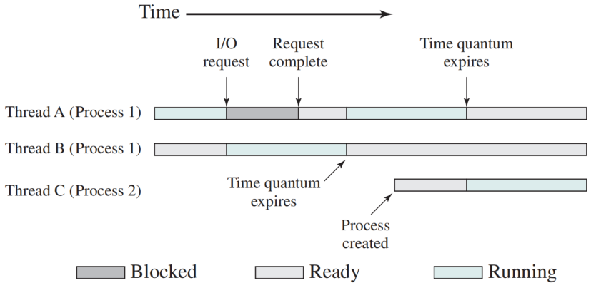
Multithreading on a Uniprocessor
On a uniprocessor, multiprogramming enables the interleaving of multiple threads within multiple processes

Slide 24
Thread Synchronization
It is necessary to synchronize the activities of the various threads
      all threads of a process share the same address space and other resources
      any alteration of a resource by one thread affects the other threads in the same process

Slide 25

4.2 Types of Threads
User Level Thread (ULT)
Kernel level Thread (KLT)

Slide 26
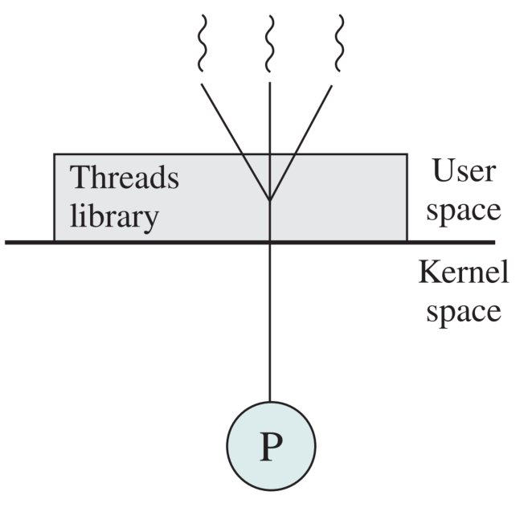
User-Level Threads (ULTs)
All thread management is done by the application
The kernel is not aware of the existence of threads
Thread library provides programmer with API for creating and managing threads
Pure user–level

Slide 27
Thread Management of ULTs
Procedures of thread spawning
Process
Tn
Thread Library
2
T1
User space
Spawn utility
T2
1
3
Save the context of T1, such as user registers, the PC, stack pointers.
Restore the the context of Tn

Slide 28
Relationships Between ULT States and Process States
Process B consists of two threads, i.e., Thread 1, and Thread 2
Thread 2 is running
Examples of the Relationships between User-Level Thread States and Process States

Slide 29
Relationships Between ULT States and Process States
Case1: T2 makes a system call,
  Controller is switched to kernel and process B is blocked by kernel.
  According to the data structure maintained by the threads library, thread 2 is still in the Running state.
Examples of the Relationships between User-Level Thread States and Process States

Slide 30
Relationships Between ULT States and Process States
Case 2: A clock interrupt
  Controller is switched to kernel and process B is blocked by kernel.
  According to the data structure maintained by the threads library, thread 2 is still in the Running state.
Examples of the Relationships between User-Level Thread States and Process States

Slide 31
Relationships Between ULT States and Process States
Case 3: thread 2 waits the results of thread 1
Examples of the Relationships between User-Level Thread States and Process States

Slide 32
Advantages of ULTs
Thread switching does not require kernel mode privileges
  all of the thread management data structures are within the user address space of a single process.
  saves the overhead of two mode switches (user to kernel; kernel back to user).
Scheduling can be application specific
  The scheduling algorithm can be tailored to the application without disturbing the underlying OS scheduler.
ULTs can run on any OS
  No changes are required to the underlying kernel to support ULTs. The threads library is a set of application-level functions shared by all applications.

Slide 33

Disadvantages of ULTs
when a ULT executes a system call, not only is that thread blocked, but all of the threads within the process are blocked (Case 1)
In a pure ULT strategy, a multithreaded application cannot take advantage of multiprocessing since kernel can only allocate process rather than thread
Writing an application as multiple processes rather than multiple threads.
  Introduce the overhead of process switching
SOLUTIONS
Jacketing(封装)
  converts a blocking system call into a non-blocking system call (using the thread library to passes control to another thread rather than the OS scheduler)

Slide 34
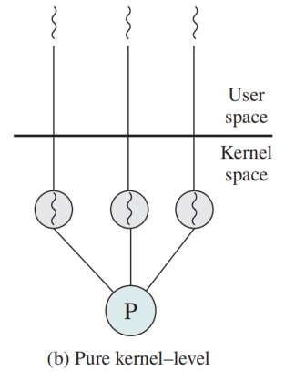
Kernel-Level Threads (KLTs)
Thread management is done by the kernel
  no thread management is done by the application
  The kernel maintains context information for the process and for individual threads within the process.
  Scheduling by the kernel is done on a thread basis.
Examples – virtually all general purpose OS
  Windows
  Solaris
  Linux
  Tru64 UNIX
  Mac OS X

Slide 35

Advantages of KLTs
The kernel can simultaneously schedule multiple threads from the same process on multiple processors
If one thread in a process is blocked, the kernel can schedule another thread of the same process
Kernel routines (内核例程) can be multithreaded

Slide 36
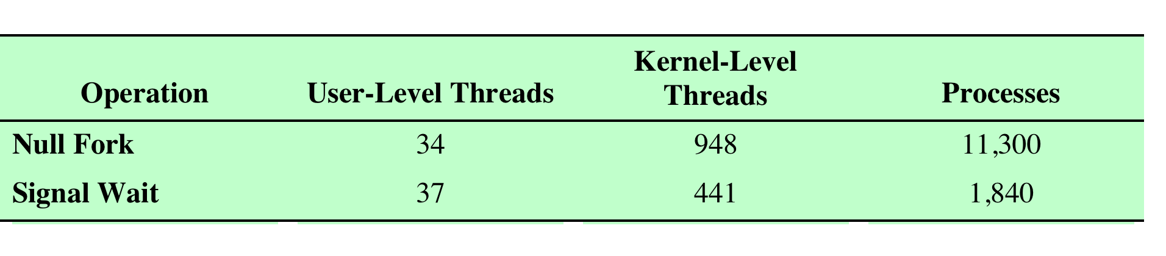

Disadvantage of KLTs
The transfer of control from one thread to another within the same process requires a mode switch to the kernel
Thread and Process Operation Latencies (us)

Slide 37
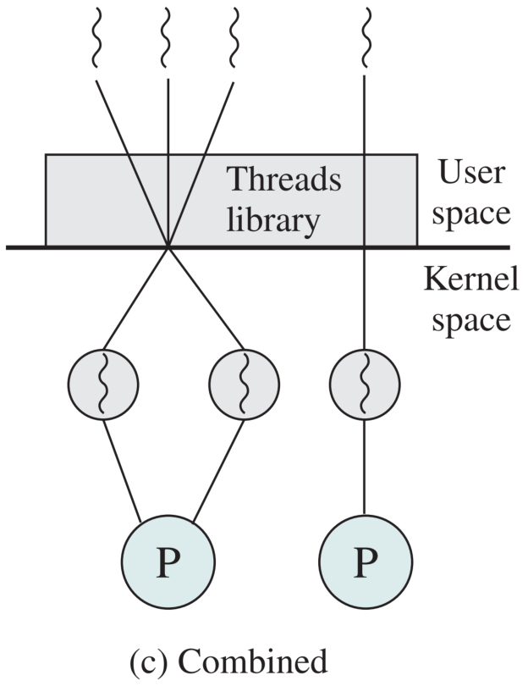
Combined Approaches
Thread creation is done in the user space
Bulk of scheduling and synchronization of threads is by the within an application
The multiple ULTs from a single application are mapped onto some (smaller or equal) number of KLTs.
The programmer may adjust the number of KLTs for a particular application and processor to achieve the best overall results.

Slide 38
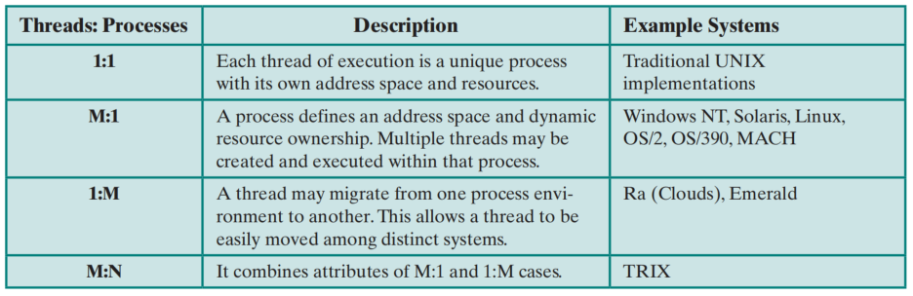
Relationship Between Threads and Processes

Slide 39
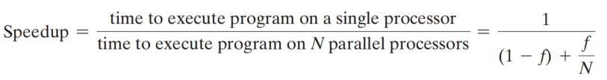
4.3 Multicore and Multithread
  The potential performance benefits of a multicore organization depend on the ability to effectively exploit the parallel resources available to the application.
  A single application running on a multicore system
Amdahl’s Law (阿姆达尔定律)
1-f：a fraction of the serial execution time
f : a fraction of the parallelizable execution time with no scheduling overhead

Slide 40
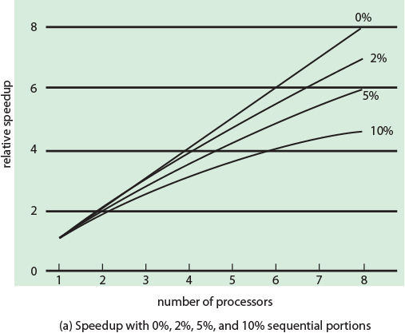
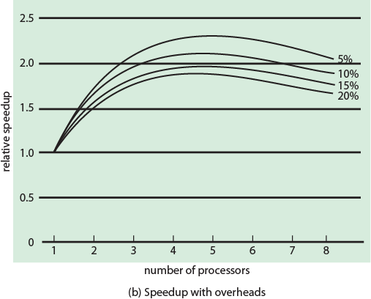
Performance Effect of Multiple Cores
Value of 1-f
e.g., communication and cache overhead
Figure 4.7 (a)
Figure 4.7 (b)

Slide 41
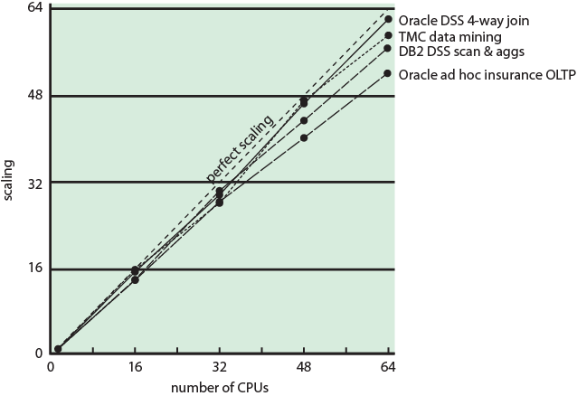
Example of Multicore for Database
Figure 4.8 Scaling of Database Workloads on Multiple Processor Hardware

Slide 42
Benefited Applications from Multicore
Multithreaded native applications
  characterized by having a small number of highly threaded processes
Multiprocessed applications
  characterized by the presence of many single-threaded processes
Java applications
Multi-instance applications
  multiple instances of the application in parallel

Slide 43
Summary
Process and Thread
  Process: virtual address space and protected access to resource
  Thread: state, context, Stack, static space, shared memory and resource
Thread state
User-level threads and kernel-level threads
Multicore and multithread

